Slide 1
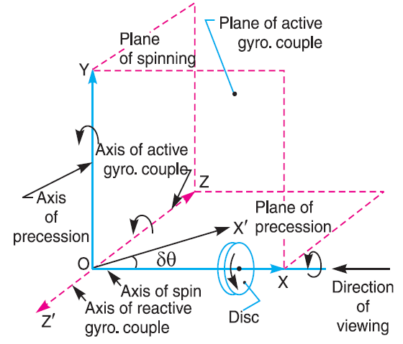
Theory of machines Wessam Al Azzawi
Gyroscope
Consider a disc spinning with an angular velocity ω rad/s about the axis of spin OX, in anticlockwise direction when seen from the front, as shown in Fig.a. Since the plane in which the disc is rotating is parallel to the plane YOZ, therefore it is called plane of spinning. The plane XOZ is a horizontal plane and the axis of spin rotates in a plane parallel to the horizontal plane about an axis OY. In other words, the axis of spin is said to be rotating about an axis OY (which is perpendicular to both the axes OX and OZ) at an angular velocity ω_{P} rap/s. This horizontal plane XOZ is called plane of precession and OY is the axis of precession.
Gyroscope-1
Gyroscope-2
Fig.a

Slide 2
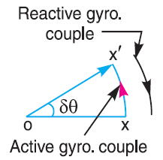
Theory of machines Wessam Al Azzawi
Gyroscope
Since the angular momentum is a vector quantity, therefore it may be represented by the vector ox, as shown in Fig.b. The axis of spin OX is also rotating anticlockwise when seen from the top about the axis OY. Let the axis OX is turned in the plane XOZ through a small angle δθ radians to the position OX ′, in time δt seconds. Assuming the angular velocity ω to be constant, the angular momentum will now be represented by vector ox′.
$$c=I.ω.\frac{δθ}{δt}=I.ω.ω_{p} \left(ω_{p}=\frac{dθ}{dt}\right)$$
where ω_{P} = Angular velocity of precession of the axis of spin or the speed of rotation of the axis of spin about the axis of precession OY.
In S.I. units, the units of C is N-m when I is in kg-m2.
Fig.b

Slide 3
Theory of machines Wessam Al Azzawi
Gyroscope
It may be noted that:
The couple I.ω.ω_{p}, in the direction of the vector xx′ is the active gyroscopic couple, which has to be applied over the disc to rotate with angular velocity ω_{P} about the axis of precession.
The vector xx′ lies in the horizontal plane. In case of a very small displacement δθ, the vector xx′ will be perpendicular to the vertical plane XOY. Therefore the couple causing this change in the angular momentum will lie in the plane XOY. The vector xx′ represents an anticlockwise couple in the plane XOY. Therefore, the plane XOY is called the plane of active gyroscopic couple and the axis OZ is called the axis of active gyroscopic couple.
Fig.a
Fig.b

Slide 4
Theory of machines Wessam Al Azzawi
Gyroscope
When the axis of spin itself moves with angular velocity ω_{P}, the disc is subjected to reactive couple whose magnitude is same (i.e. I. ω.ω_{P}) but opposite in direction to that of active couple. This reactive couple to which the disc is subjected when the axis of spin rotates about the axis of precession is known as reactive gyroscopic couple. The axis of the reactive gyroscopic couple is represented by OZ′ in Fig.a.
The gyroscopic couple is usually applied through the bearings which support the shaft The bearings will resist equal and opposite couple.
Fig.a
Fig.b

Slide 5
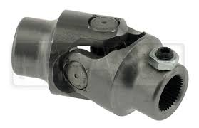
Theory of machines Wessam Al Azzawi
Gyroscope
The gyroscopic principle is used in an instrument or toy known as gyroscope. The gyroscopes are installed in ships in order to minimize the rolling and pitching effects of waves. They are also used in aeroplanes, monorail cars, gyrocompasses etc.

Slide 6
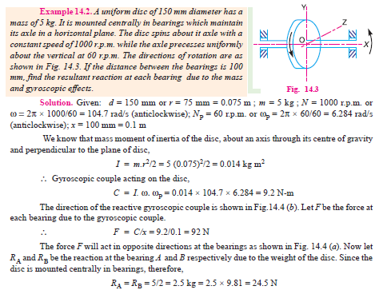
Theory of machines Wessam Al Azzawi
Gyroscope

Slide 7
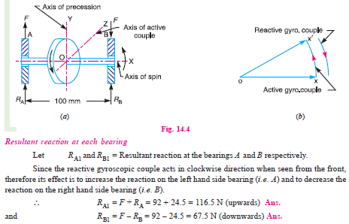
Theory of machines Wessam Al Azzawi
Gyroscope

Slide 8
Theory of machines Wessam Al Azzawi
Gyroscope

